Slide 1
Structured Query Language
BY:-
NAME:-V.PRANEETH SAI.
EMP-ID:-46075966.
BATCH:-BI-MS AZURE APRIL-22nd.

Slide 2
AGENDA
What is SQL?
SQL Commands
Constraints
Index in SQL
Partitions in SQL
Advantages of SQL

Slide 3
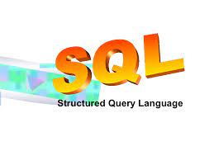
WHAT IS SQL?
SQL (Structured Query Language) is a computer language aimed to store, manipulate, and retrieve data stored in relational databases.
IBM implemented the language, originally called Sequel, as part of the System R project in the early 1970s.
The first commercial relational database was released by Relational Software later becoming oracle.

Slide 4

SQL Commands
Data-definition language (DDL).
Data Manipulation Language (DML).
Data Control Language (DCL).
Transaction Control Language (TCL).

Slide 5
(Cont..)
Data Definition Language (DDL):
Create
Rename
Truncate
Alter
Drop

Slide 6
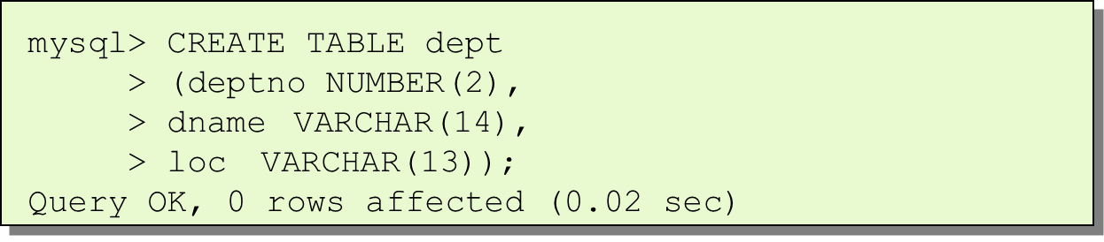
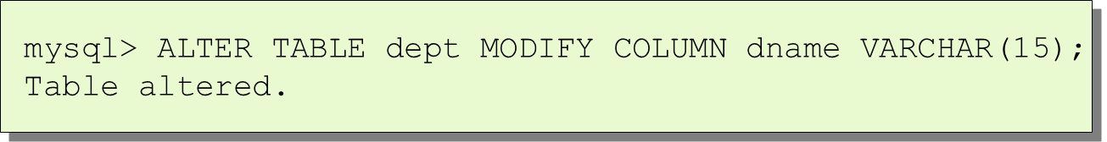
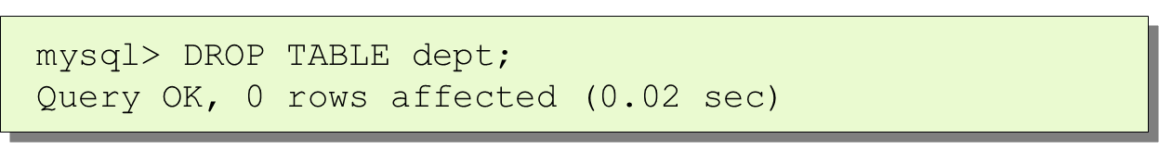
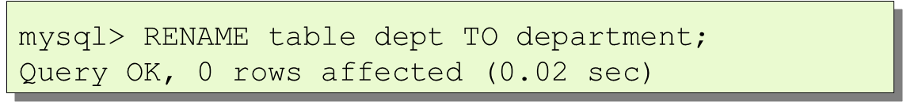
DDL (Cont.)
Statements used to define the database structure or schema.
Some examples:
CREATE - to create objects in the database .
ALTER - alters the structure of the database .
DROP - delete objects from the database .
RENAME - rename an object.

Slide 7
Constraints
SQL constraints are used to specify rules for the data in a table.
Constraints are used to limit the type of data that can go into a table. This ensures the accuracy and reliability of the data in the table. If there is any violation between the constraint and the data action, the action is aborted.
Constraints can be column level or table level. Column level constraints apply to a column, and table level constraints apply to the whole table.

Slide 8
Cont.
The following constraints are commonly used in SQL:
NOT NULL - Ensures that a column cannot have a NULL value
UNIQUE - Ensures that all values in a column are different
PRIMARY KEY - A combination of a NOT NULL and UNIQUE. Uniquely identifies each row in a table
FOREIGN KEY - Prevents actions that would destroy links between tables
CHECK - Ensures that the values in a column satisfies a specific condition
DEFAULT - Sets a default value for a column if no value is specified
CREATE INDEX - Used to create and retrieve data from the database very quickly

Slide 9
Cont.
For Example:
SQL Create Constraints:
Constraints can be specified when the table is created with the CREATE TABLE statement, or after the table is created with the ALTER TABLE statement.
SYNTAX:
CREATE TABLE table_name ( column1 datatype constraint, column2 datatype constraint, column3 datatype constraint, .... );

Slide 10
INDEX IN SQL
Indexes are used to retrieve data from the database more quickly than otherwise. The users cannot see the indexes, they are just used to speed up searches/queries.
CREATE INDEX:
Creates an index on a table. Duplicate values are allowed.
Syntax:
CREATE INDEX index_name ON table_name (column1, column2, ...);
CREATE UNIQUE INDEX:
Creates a unique index on a table. Duplicate values are not allowed.
Syntax:
CREATE UNIQUE INDEX index_name ON table_name (column1, column2, ...);

Slide 11
Cont.
For Example: CREATE INDEX
The SQL statement below creates an index named "idx_lastname" on the "LastName" column in the "Persons" table:
Syntax:
CREATE INDEX idx_lastname ON Persons (LastName);
DROP INDEX:
The DROP INDEX Statement is used to delete an index in a table.
Syntax:
DROP INDEX table_name.index_name;

Slide 12
Partitions in SQL
Partitioning in SQL Server divides the information into the smaller storage groups; It is about table data and indexes.
Partition function can be used with the table column when a table creates.
A partition can be defined with the name and its storage attributes.
Partitioning is dividing of stored database objects (tables, indexes, views) to separate parts.
Partitioning is used to increase controllability, performance and availability of large database objects.
In some cases, partitioning improves performance when accessing the partitioned tables.
We get all records in a table using the PARTITION BY clause. It gives one row per group in result set.
For example, we get a result for each group of CustomerCity in the GROUP BY clause. It gives aggregated columns with each record in the specified table.

Slide 13
Cont.
There are two types of Partitioning in SQL Server:
1)Vertical Partitioning.
2)Horizontal partitioning.
Vertical Partitioning:
Vertical partitioning is nothing but to split tables vertically.
For Example:
Consider an employee table having employee name, employee address, employee city, employee id, employee number, and employee salary. Here HR needs to analyze employee data and generate reports on daily basis.
Employee address and employee city are not required, Employee ID, number, name, and salary -- these columns are used constantly to fetch reports so you can split these columns in another chunk . This becomes easier for fetching reports.

Slide 14
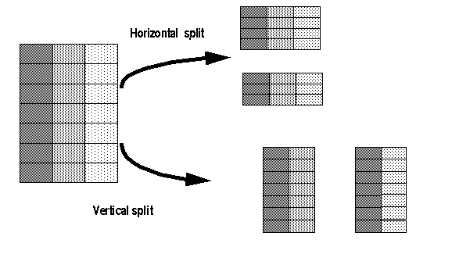
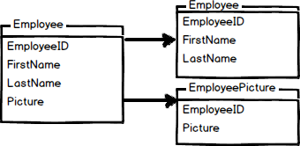
Cont.
Vertical split or partitioning is done on columns.
Vertical table partitioning is mostly used to increase SQL Server performance especially in cases where a query retrieves all columns from a table that contains a number of very wide text or BLOB columns. In this case to reduce access times the BLOB columns can be split to its own table.
Vertical partitioning splits a table into two or more tables containing different columns.

Slide 15
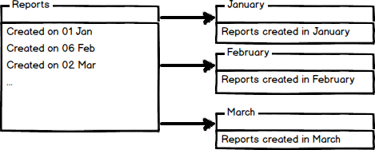
Cont.
Horizontal partitioning:
Horizontal partitioning divides a table with the same number of columns with fewer rows .
Horizontal partitioning divides a table into multiple tables that contain the same number of columns, but fewer rows.
For example, if a table contains a large number of rows that represent monthly reports it could be partitioned horizontally into tables by years, with each table.
This way queries requiring data for a specific year will only reference the appropriate table. Tables should be partitioned in a way that queries reference as few tables as possible.

Slide 16
Advantages of SQL:
Easy to Install.
Enhanced Performance.
Several SQL Server Editions.
Highly Secure.
Excellent Data Restoration and Recovery Mechanism.
Lower Cost of Ownership.

Slide 17


